Slide 1
PYTHON UTILITY TOOLS
- Bhavya Sehgal

Slide 2
WHAT IS PYTHON UTILITY TOOL
A tool that will contain all the necessities for a user on the internet. It will have the following:
Link Shortener – A program that enables users to shorten links. This will reduce the size of the links as well as even make it easy for the user to remember, in case of needs.
YouTube Video Downloader – As the name suggests it will help users to download video from YouTube and store them on their device in any chosen format.
Instagram Post Downloader – It will allow users to download High Quality images from Instagram.
JPG to PNG Convertor – This will enable user to convert JPG files to PNG or vice versa, as for some forms jpg and for others png is used.
Currency Calculator – This will help user to convert currencies in real time prices.
File Organizer - This will help user to organize not only their desktop but also their folders and sort files according to there particular extensions into different folders.

Slide 3
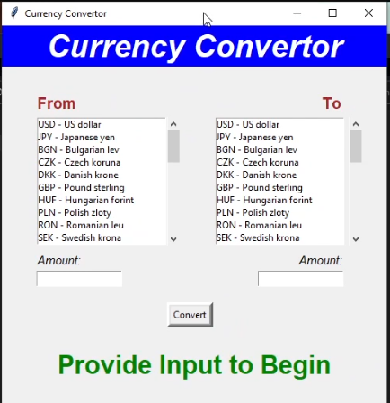
CURRENCY CONVERTOR
Libraries Used:
Tkinter and forex-python
pip install forex-python
Working:-
This currency convertor has a simple GUI design. It contains Two Lists of currencies. First list is the Currency From list
and the second list is Currency To list. It contains an Input Field where the user can input the amount. After all the
required inputs, the output is displayed in another Output Amount Field.
(Requirements):
Working Internet connection with down speed of atleast 1Mbps

Slide 4
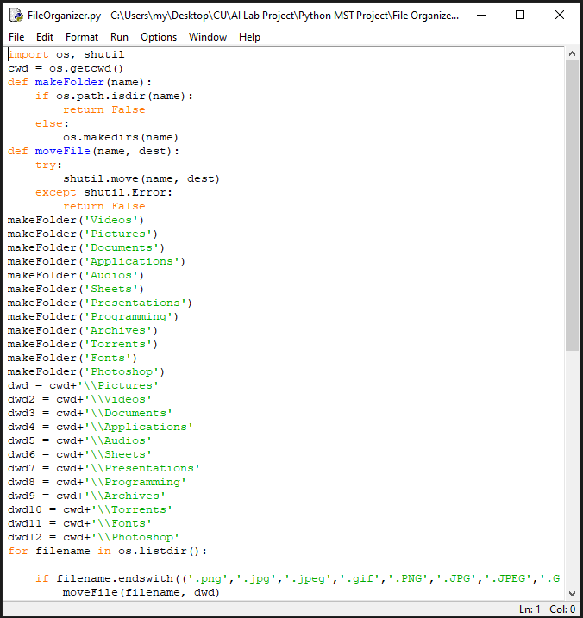
FILE ORGANIZER
Libraries Used:
Os and shutil
Working:-
This is a simple program which segregates the files into different folders depending on their format. Firstly the program makes
Multiple folders like Video, Pictures, Documents etc. and then moves the files into these folders based on their extension, for example all
the files having the extension as .jpg or .png or .gif are moved to the folder named images.
(Requirements):
Working Internet connection with down speed of atleast 1Mbps

Slide 5
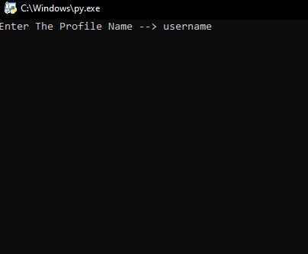
INSTAGRAM DOWNLOADER
Libraries Used:
Instaloader
pip install instaloader
Working:-
This is a very simple program to download the profile picture of a particular user on instagram. Using the instaloader library you can
directly enter the username of a user with the @ symbol and the file automatically creates a folder containing the DP of the user.
(Requirements):
Working Internet connection with down speed of atleast 1Mbps

Slide 6
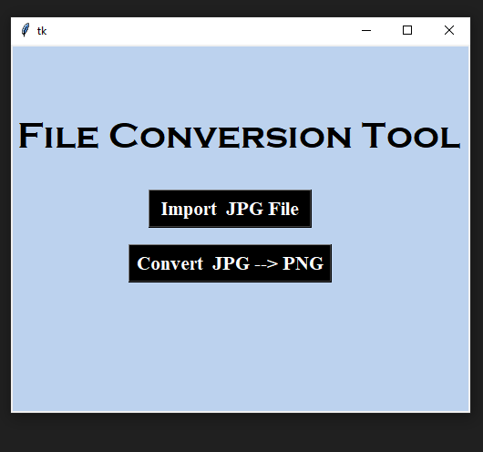
JPG TO PNG CONVERTOR
Libraries Used:
Using sys, os and PIL(Image Filter)
PIL PACKAGE- pip install pillow
Working:-
JPG to PNG is a type of file conversion tool in which we convert a type of file into another type of file.
and for this we import an image from our path where the file is stored and then we click on convert JPG-->PNG TOOL and
allocate the path to store that file by taking a new name for that file(image).
(Requirements):
A JPG File

Slide 7
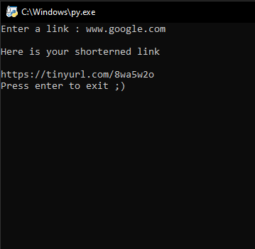
URL SHORTENER
Libraries Used:
pip install pyshorteners
Working:-
Using the pyshorteners library we are easily able to convert the link in to a tiny url. Which can be used to share to an audience, this removes
the hassle of going to multiple malicious websites and searching for a good url converter.
(Requirements):
Working Internet connection with down speed of atleast 1Mbps

Slide 8
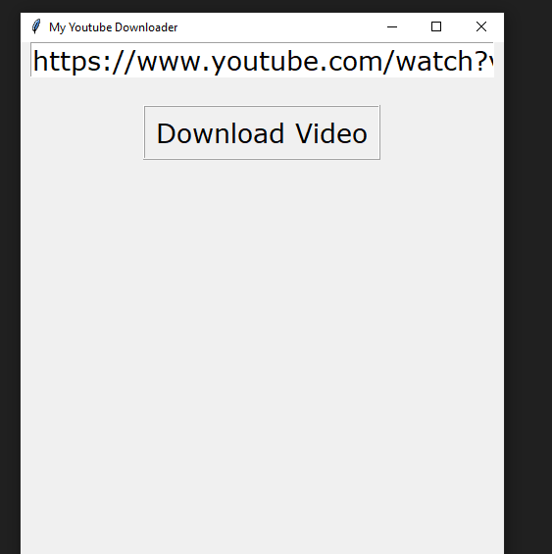
YOUTUBE DOWNLOADER
Libraries Used:
pytube
pip install pytube
Working:-
Using pytube we are able to run the url of the video through and download the video without any other files. The downloader downloads the video in the
best possible video quality.
(Requirements):
Working Internet connection with down speed of atleast 5Mbps

Slide 9
UNDERSTANDING THE PROBLEM
VIRUS
PRICING
Most of these websites right now are malicious and provide outputs in zip folders that may contain virus and silent miners.
A lot of websites charge users for using their service, and if they don’t charge they put disturbing ads for their income.

Slide 10
HOW WE WILL TACKLE THIS
01
02
03
CURRENT PROBLEM
OUR PROCESS
OUR TARGET
Users need to visit multiple websites for different tasks.
We will put all basic needs of the user at one place.
A single website/app that will do it all.

Slide 11
OUR PROCESS
PRESENT
IMPROVE
STAGE 02
STAGE 04
STAGE 01
STAGE 03
PERFROM
SUBMIT
Present our idea
to you
Finding bugs and improving upon them.
Create a functional code.
Submit the project after in-depth review.

Slide 12
OUR SOLUTION
SAVE TIME
FREE OF COST
COMMUNITY
EXPAND
Save time of the user of going to multiple websites.
Providing this
Service free of cost to all users.
Get user inputs for new additions and improvements
Expand with learning from user inputs and criticism.

Slide 13
OUR MOTIVE
This is a problem we don’t realize yet but will in future.
1. Prioritize user privacy.
2. Improve user experience.
3. Reduce user hassle.
4. Reduce use of malicious websites.
5. Expand into a big functional tool.

Slide 14
THANK YOU

